Slide 1

Impact of
AI
Job markets

Slide 2


Questions:
Q1
Analyzing the impact of AI adoption on different industries
Understanding which skills are in demand across industries
Q2
Q3
Analyzing the impact of AI adoption on different job roles
Identifying job roles at high risk of automation and strategizing for workforce transitions
Q4
Q5
AI adoption and salary ranges across different job roles
AI adoption and salary ranges across different locations
Q6

Slide 3
Questions:
Q7
Analyzing growth of job roles with high level of AI adoption
Analyzing which skills are needed with the impact of automation risk
Q8
Q9
Analyzing impact of AI adoption on company size
Impact of remote friendly jobs on salary
Q10
Q11
Understanding which skills are in demand in remote friendly job
Which skills are in demand across locations
Q12

Slide 4
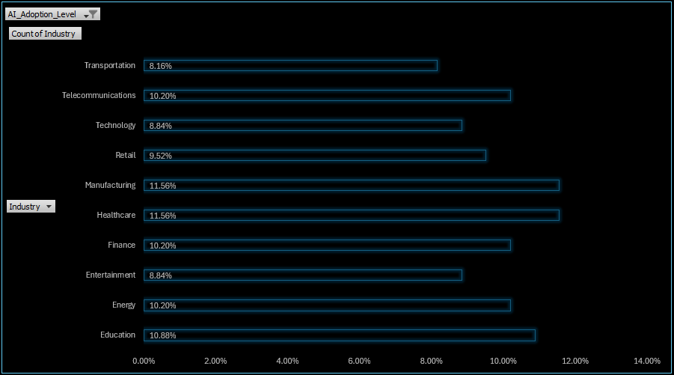
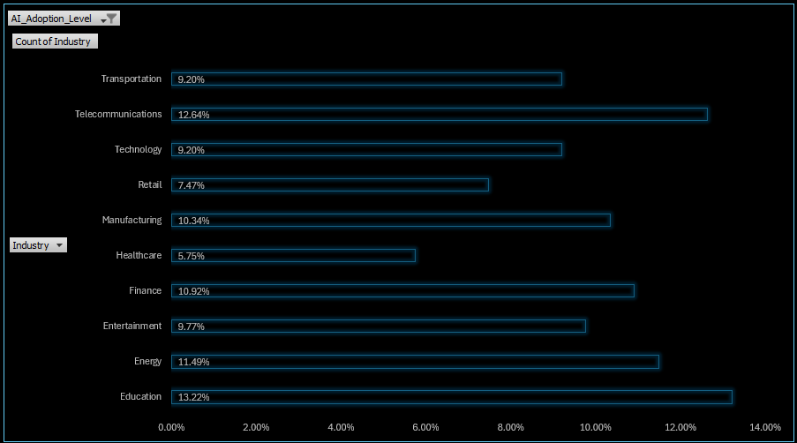
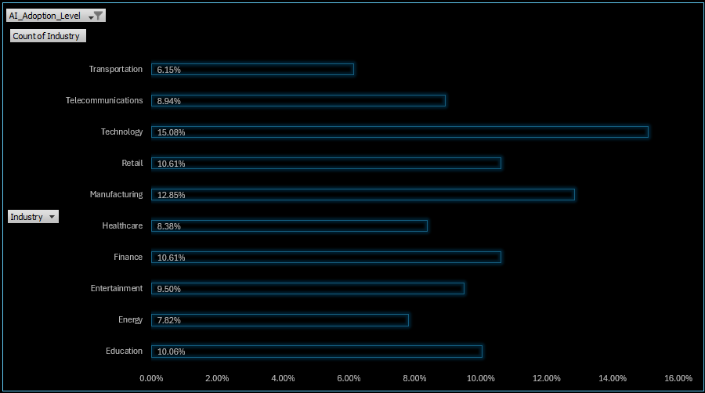
Interpretation:
Q1
Analyzing the impact of AI adoption on different industries
High
Medium
Low
Heath-care and Manufacturing industries has highly adopted AI among all other industries significantly by 11.56%.
Lowest impact of AI is in Education industry

Slide 5
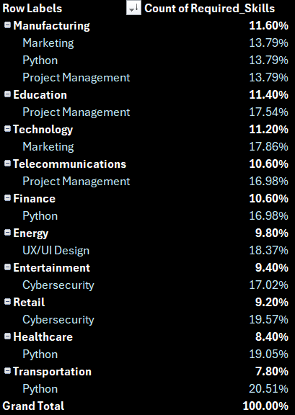
Interpretation:
Understanding which skills are in demand across industries
Q2
Python is an essential skill that most industries require.

Slide 6
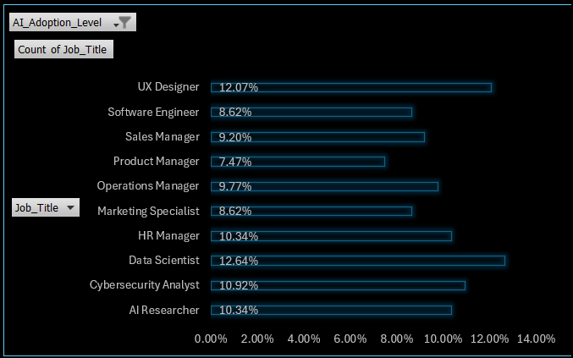
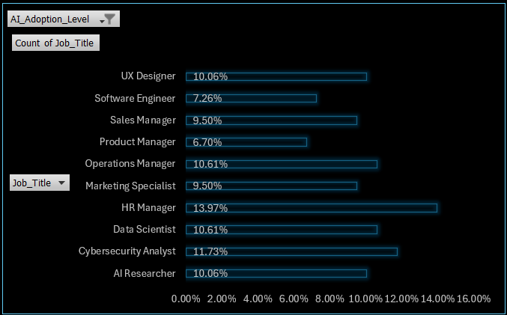
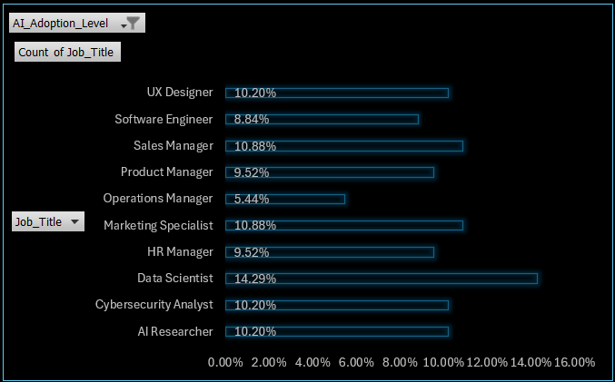
Interpretation:
Q3
Analyzing the impact of AI adoption on different job roles
High
Medium
Low
Data scientist job roles has highly adopted AI among all other significantly by 14.29%.
HR manager are on the way of adopting AI

Slide 7
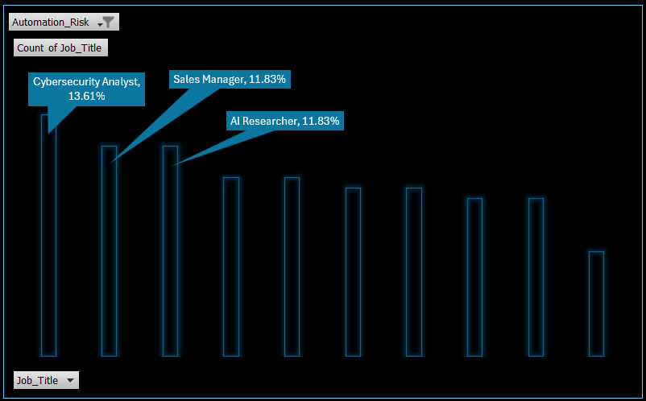
Interpretation:
Identifying job roles at high risk of automation and strategizing for workforce transitions
Q4
Cybersecurity analyst are at the highest risk of automation.

Slide 8
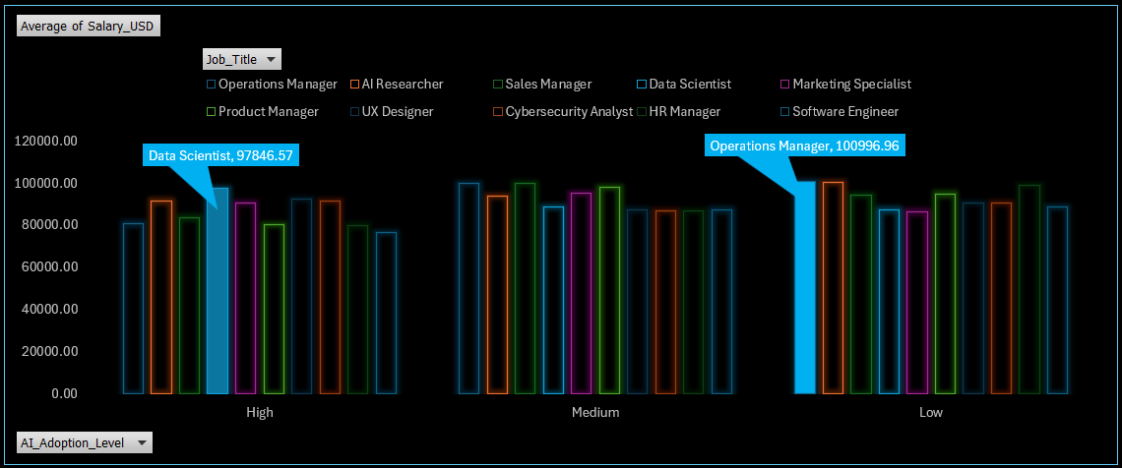
Interpretation:
Q5
AI adoption and salary ranges across different job roles
When AI adoption is high, Data scientist typically earn highest salaries and when it’s low the high-earning people are the operations managers

Slide 9
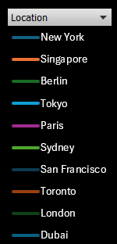

Interpretation:
High, 92098.87
AI adoption and salary ranges across different locations
Q6
When AI adoption is high, Paris gives highest salaries and when it’s low the high-earning location is Singapore
Medium, 91455.55
Low, 92060.45

Slide 10
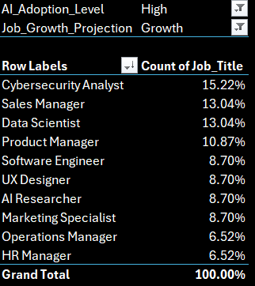
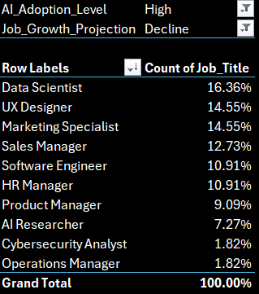
Interpretation:
Q7
Analyzing growth of job roles with high level of AI adoption
Growth for Cybersecurity analysts is highest and for Data scientist is lowest when the application of AI is strong

Slide 11
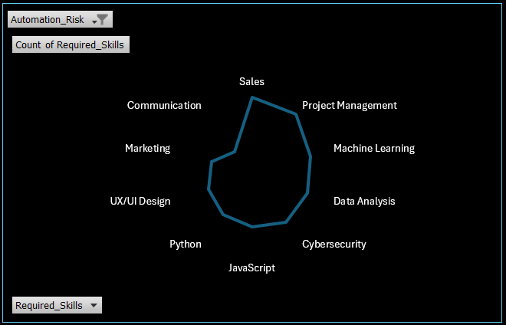
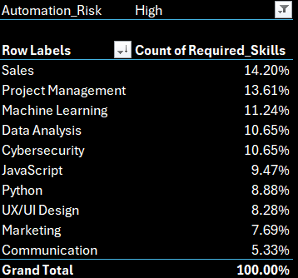
Interpretation:
Analyzing which skills are needed with the impact of automation risk
Q8
With high automation risk sales is the required skills to be possessed

Slide 12
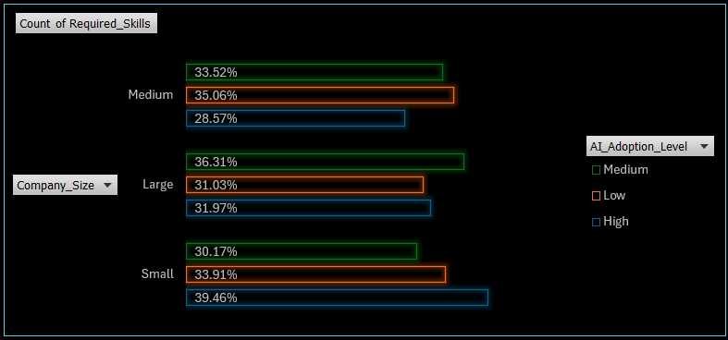
Interpretation:
Q9
Analyzing impact of AI adoption on company size
Company with small size adopts high level of AI compared to Large size

Slide 13
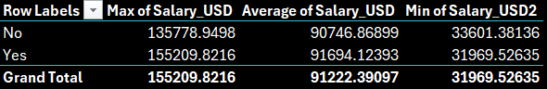
Interpretation:
Impact of remote friendly jobs on salary
Q10
People who do remote friendly jobs earns more than the ones going to office

Slide 14
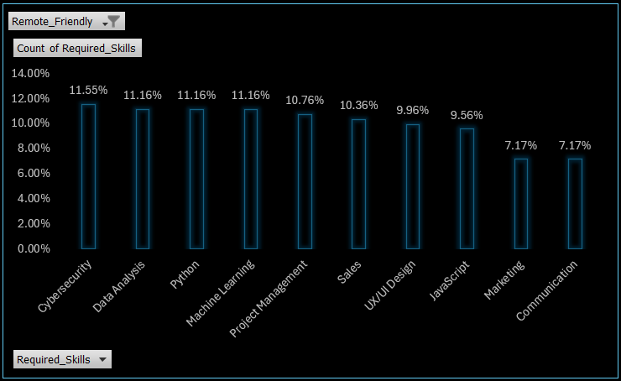
Interpretation:
Q11
Understanding which skills are in demand in remote friendly job
Cybersecurity is the most required skills for remote friendly jobs

Slide 15
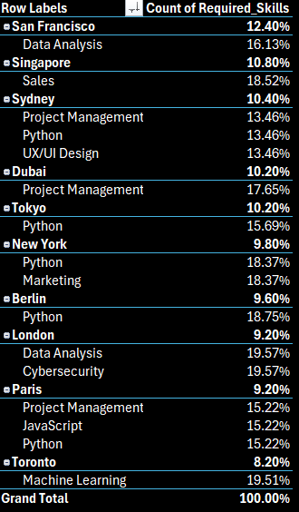
Interpretation:
Which skills are in demand across locations
Q12
Python and Project management are an essential skill across locations

Slide 16
Conclusion

Slide 17
Cybersecurity is crucial for remote-friendly jobs and is associated with the highest growth in terms of job prospects. However, cybersecurity analysts are at a high risk of automation, indicating a potential threat to job stability despite high demand.
With increased automation, sales skills become more important to mitigate the risks associated with automation.
Data scientists typically earn the highest salaries when AI adoption is high. In cities like Paris, where AI adoption is high, salaries are also higher.
Conclusion

Slide 18

Thank
you

